Slide 1
Overlapp
Team 5
Ally Wilson, Harrison Condon, Terri Cassells, and Veronika Strela

Slide 2
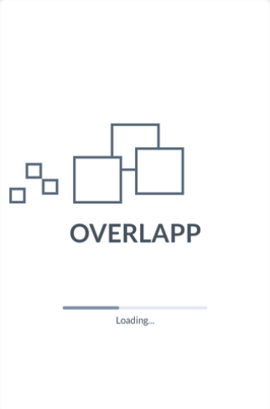
Overlapp: An Introduction
Problem Space:
Organisation
Teamwork Collaboration
Time Management

Slide 3
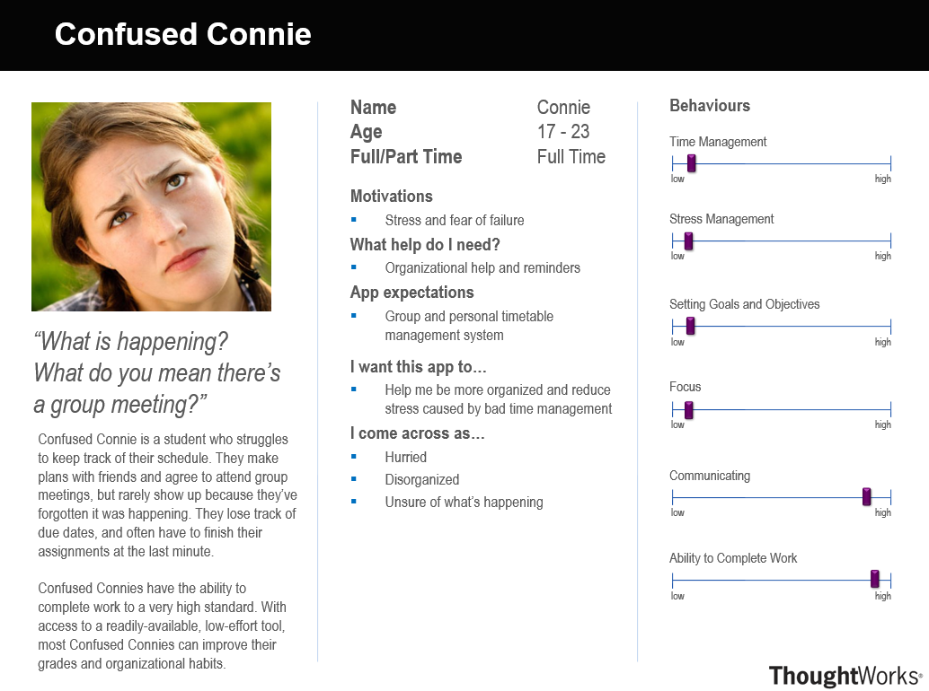
User Type / Persona 1

Slide 4
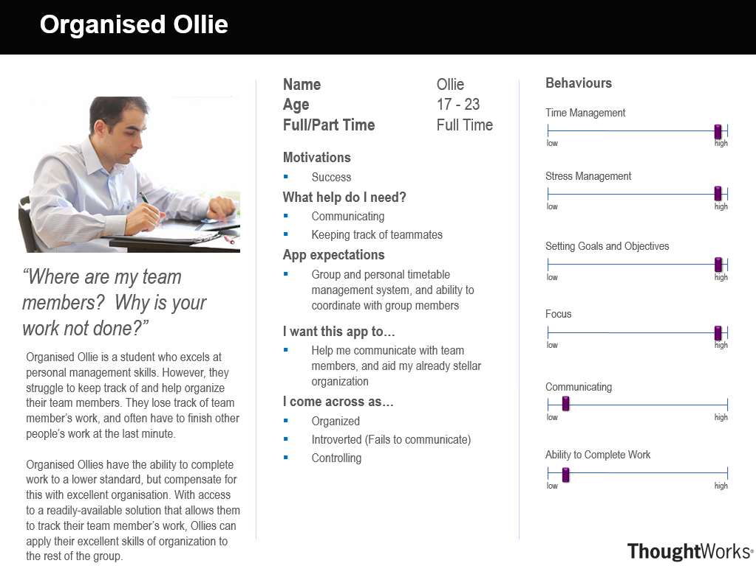
User Type / Persona 2

Slide 5
Competitors
My Study Life – School Planner
QUT Blackboard / Virtual
Microsoft Outlook
Google Calendar
Assignment Calculator

Slide 6
My Study Life – School Planner

Slide 7
QUT Blackboard / Virtual

Slide 8
Microsoft Outlook & Google Calendar

Slide 9
Assignment Calculator

Slide 10
Comparison of Competitors

Slide 11
Interactive Prototype Demo
https://marvelapp.com/project/2845606/

Slide 12
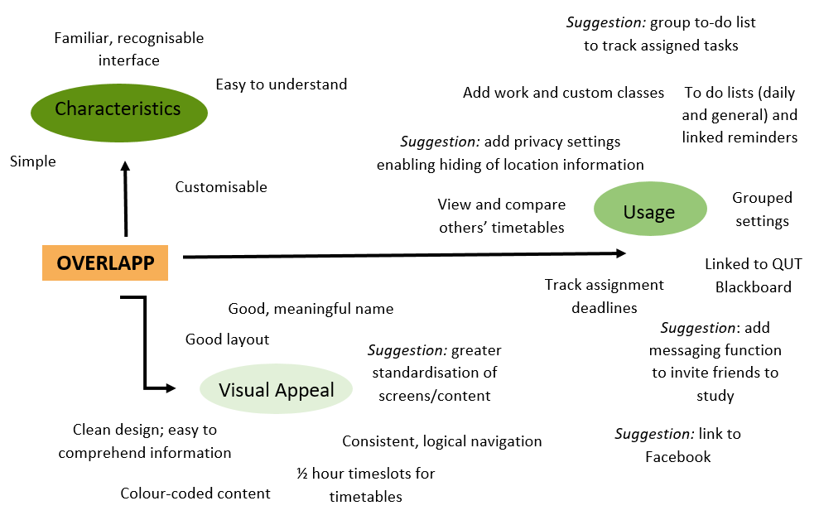
Feedback & Review

Slide 13
Conclusion
Name of Application: Overlapp
Purpose: To help QUT students to better organise their group meetings, group tasks, timetables, to do lists and calendars.
Major features:
Calendar Functionality
To-Do List Creation and Management
Overlapping of timetables with groups and individuals
Assignment, exams and homework organisation

